Slide 1

Exception Handling

Slide 2
Today’s Agenda
Exception Handling
Advantage of Exception Handling
Hierarchy of Exception classes
Types of Exception
Scenarios where exception may occur

Slide 3
What is exception
Dictionary Meaning: Exception is an abnormal condition.
In java, exception is an event that disrupts the normal flow of the program. It is an object which is thrown at runtime.

Slide 4
What is exception handling
The exception handling in java is one of the powerful mechanism to handle the runtime errors so that normal flow of the application can be maintained.
Exception Handling is a mechanism to handle runtime errors such as ClassNotFound, IO, SQL, Remote etc.

Slide 5
Advantage of Exception Handling
The core advantage of exception handling is to maintain the normal flow of the application. Exception normally disrupts the normal flow of the application that is why we use exception handling.

Slide 6
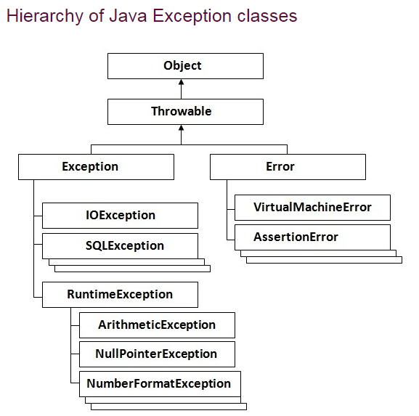
Hierarchy of JAVA Exceptions in Classes

Slide 7
Types of Exception
There are mainly two types of exceptions: checked and unchecked where error is considered as unchecked exception. The sun microsystem says there are three types of exceptions:
Checked Exception
Unchecked Exception
Error

Slide 8
Difference between checked and unchecked exceptions
1) Checked Exception
The classes that extend Throwable class except RuntimeException and Error are known as checked exceptions e.g.IOException, SQLException etc. Checked exceptions are checked at compile-time.
2) Unchecked Exception
The classes that extend RuntimeException are known as unchecked exceptions e.g. ArithmeticException, NullPointerException, ArrayIndexOutOfBoundsException etc. Unchecked exceptions are not checked at compile-time rather they are checked at runtime.
3) Error
Error is irrecoverable e.g. OutOfMemoryError, VirtualMachineError, AssertionError etc

Slide 9
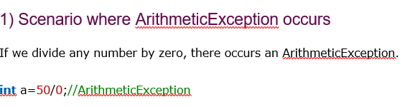
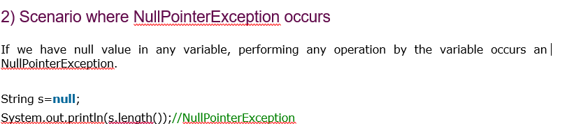
Common scenarios where exceptions may occur

Slide 10
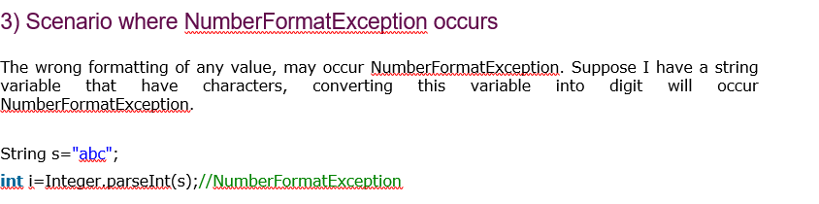
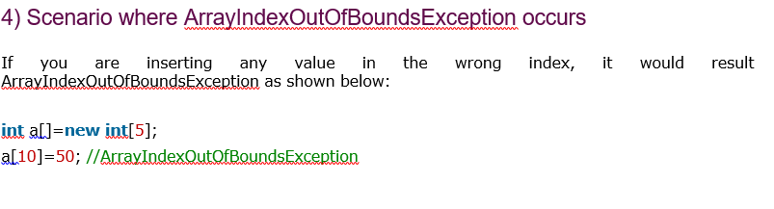
Common scenarios where exceptions may occur

Slide 11
Java Exception Handling Keywords
There are 5 keywords used in java exception handling.
try
catch
finally
throw
throws

Slide 12
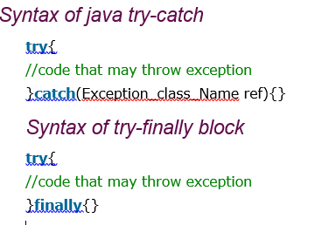
Java try-catch
Java try block
Java try block is used to enclose the code that might throw an exception. It must be used within the method.
Java try block must be followed by either catch or finally block
Java catch block
Java catch block is used to handle the Exception. It must be used after the try block only.
You can use multiple catch block with a single try.

Slide 13
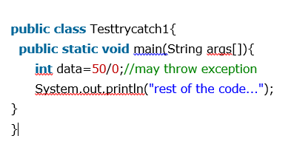
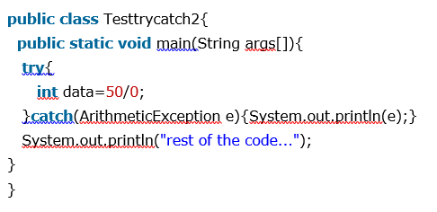
Java try-catch
Problem without exception handling
Solution by exception handling

Slide 14
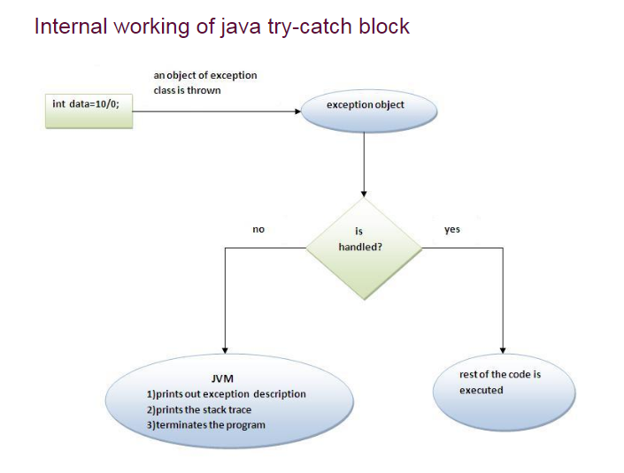
Java try-catch

Slide 15
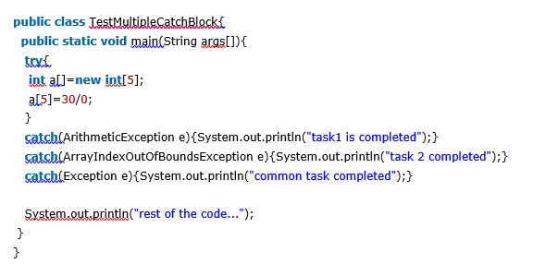
Java catch multiple exceptions

Slide 16
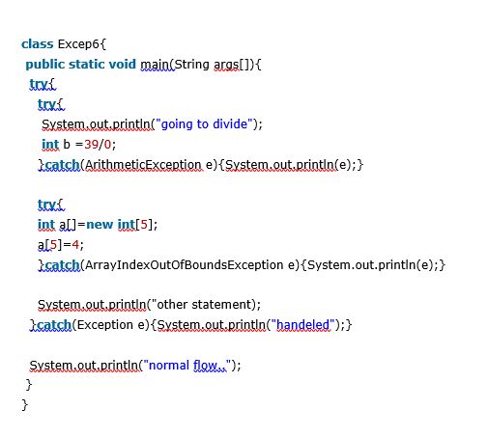
Java Nested try block

Slide 17
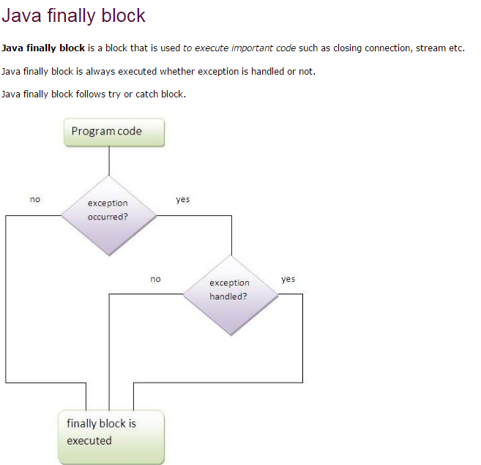
JAVA Finally Block

Slide 18
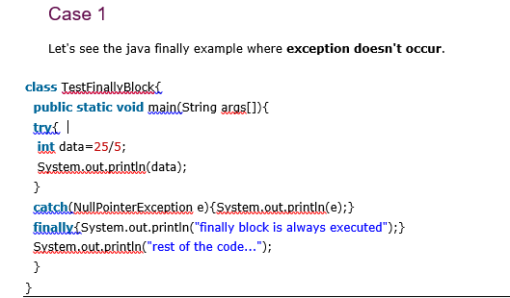
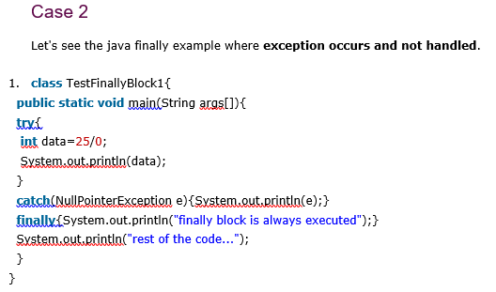
JAVA Finally Block
Why use java finally
Finally block in java can be used to put "cleanup" code such as closing a file, closing connection etc.

Slide 19
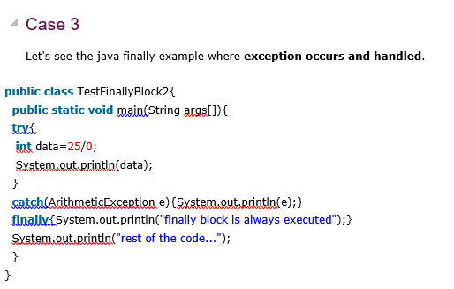
JAVA Finally Block

Slide 20
JAVA throw exception
Java throw keyword:
The Java throw keyword is used to explicitly throw an exception.
We can throw either checked or uncheked exception in java by throw keyword. The throw keyword is mainly used to throw custom exception. We will see custom exceptions later.

Slide 21
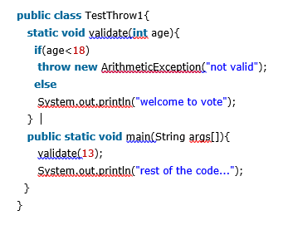
JAVA throw exception

Slide 22
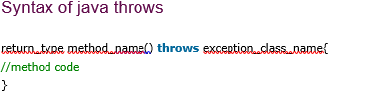
JAVA throws keyword
The Java throws keyword is used to declare an exception. It gives an information to the programmer that there may occur an exception so it is better for the programmer to provide the exception handling code so that normal flow can be maintained.
Exception Handling is mainly used to handle the checked exceptions. If there occurs any unchecked exception such as NullPointerException, it is programmers fault that he is not performing check up before the code being used.

Slide 23
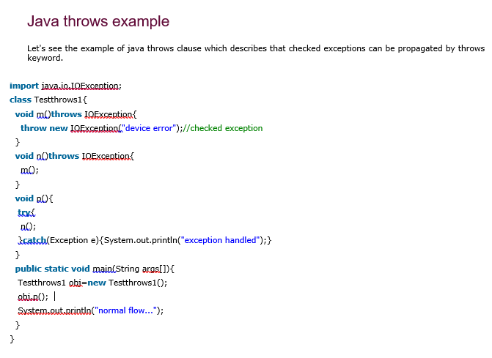
JAVA throws keyword

Slide 24
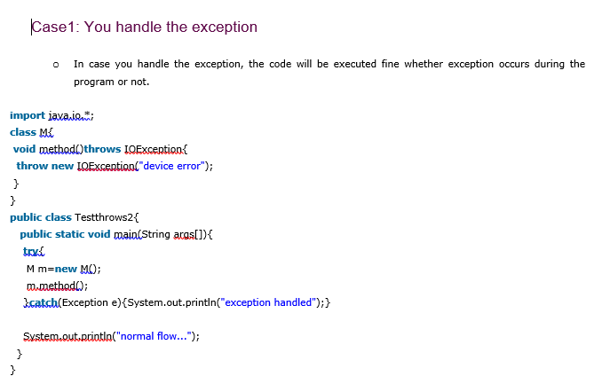
JAVA throws keyword

Slide 25
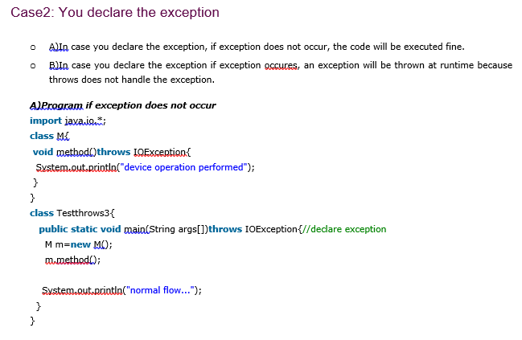
JAVA throws keyword

Slide 26
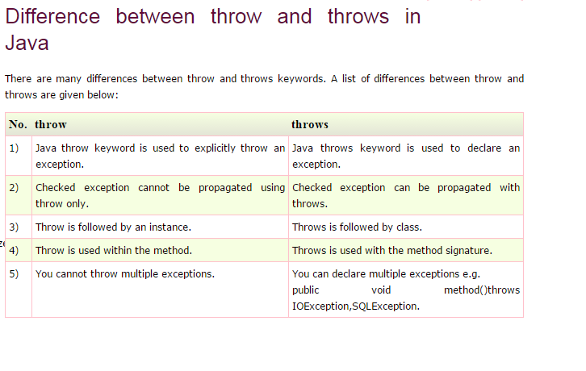
Throw & Throws Exception

Slide 27
Any Question
THANK YOU ☺

